Slide 1

Capstone Project Team: Data Titans
Team Members:
SOUMYA RANJAN RATH
ABHINASH NAYAK
ABHISEKH PATRO
SHAILEE SWASTIK

Slide 2
Introduction
World peace was one of the primary motivations for establishing the United Nations.
Terrorism is the greatest obstacle to global peace. Terrorism is frequently disregarded by those who are not immediately impacted by its dangers.
Terrorism is generally regarded as an unpredictable and tragic tragedy that disproportionately affects certain regions of the world.
On the basis of the location of the incidents, the general public has extremely limited information about similar occurrences in other areas of the world and therefore responds differently.
This research focuses on terrorism by analysing the dataset supplied by an unidentified source in order to discover significant trends and statistics.
It's difficult to define terrorism. The United Nations General Assembly is unable to come to an understanding on a single definition of terrorism at this time.
Different governments and organisations define terrorism differently as a result of this issue.
This ambiguity generates many conflicts regarding which events constitute terrorism and which do not. Various organisations define terrorism differently and conduct their business appropriately.
As a result, the contents of terrorism-related datasets collected by independent groups may differ significantly . Consequently, the analyses and outcomes of this study may differ from identical studies performed on a different dataset.

Slide 3
Global Terrorism Database
The Global Terrorism Database (GTD) is an open-source database including information on terrorist attacks around the world from 1970 through 2017. The GTD includes systematic data on domestic as well as international terrorist incidents that have occurred during this time period and now includes more than 180,000 attacks.
The database is maintained by researchers at the National Consortium for the Study of Terrorism and Responses to Terrorism (START), headquartered at the University of Maryland.
Now We have the Database to work on the Analysis on Global Terrorism from 1970 to 2017.

Slide 4
Misconceptions About Terrorism
Terrorism is intermittent, pervasive, and inconsistent with time and nature.
Due to these qualities, it is impossible to synthesise all aspects of international terrorism into a single, convincing solution and make this knowledge accessible to the general public .
Exploring this dataset can reveal how different factors are associated with one another, hence facilitating the identification of unknown hidden patterns.
This investigation will also present sufficient evidence to justify certain popular fallacies about terrorism .
One of the common misunderstandings is that a larger military can repress and control terrorism.

Slide 5
Factors affecting the Terrorism
Identifying terrorism's dependant elements is one of the objectives of this study.
Religion
Nationality
Government

Slide 6
Data Processing and Contemplation of Data:

Slide 7
Dataset Challenges
This dataset presents a significant problem due to the fact that individual investigations lead to contradictory outcomes.
Current deficiencies and limits in data gathering methodologies, arguments over definitions, and irregularities in coding and processing give rise to disagreements among researchers, so invalidating their conclusions .
A heuristic casual model showing relationships between globalisation and terrorism must be supported by an acceptable level of theoretical and empirical study .
Critical disagreement over the definitional arguments surrounding major terrorist acts has a negative impact on the growth of this area .
This issue necessitates exercising the requirement for common grounds that can be acknowledged by the majority of specialists and relevant authorities in order to agree on what may be the standard norms and method to be deemed a valid piece of information on terrorism upon which proper study can be conducted .

Slide 8
DATA PRE-PROCESSING
After data collection, the first stage is data pre-processing. It is a series of operations done on dataset to change unclear data that can impede analytical conclusions. Raw data is essentially a collection of interconnected information. Oftentimes, raw data is unstructured and contains a great deal of information that is unnecessary to the project's requirements. Methodologies for data preparation facilitate the transformation of these raw data into a more meaningful, focused, interpretable, and readable manner.
The dataset from the Global Terrorism Database is insufficient, inconsistent, and contains several errors, missing attribute values, outliers, improper tags, and duplicate entries. These disparities can be resolved through data preparation.
The steps employed in this project's data pre-processing methodology are as follows:
Data Cleaning: Filling in missing numbers, removing outliers, and handling irregularities in data constitute the data cleaning process. Numerous categories, such as 'motives' and 'responsible organisations,' are absent from the terrorist dataset due to a lack of information or because the field was irrelevant to the incident in question.

Slide 9
DATA PRE-PROCESSING (continued)
Data integration: In this phase, data discrepancies are settled. To avoid misunderstanding and redundancy, different representations of the same data are combined, such as multiple heads killed and wounded to Casualty.
Data transformation: Here data aggregation, generalisation, and normalisation are conducted. The dataset contains several subtypes of target and victim. All of these subtypes were aggregated to reflect a single value by adding all subtypes with similar characteristics. This method minimises the overall number of attributes in the dataset, hence minimising the data's variability.
The dataset features a significant degree of data sparsity, which raises its overall dimensionality. This strategy diminishes the efficacy of density-related procedures such as clustering and outlier detection. Multiple fields include a greater number of missing or null values than legitimate ones.

Slide 10
Technologies Used:
Python is an advanced programming language that supports multiple platforms, including Windows, Linux, Mac, and Raspberry Pi, among others. Python can be used to build online applications, database systems, manage large amounts of data, and conduct complicated mathematical calculations. Python is object-oriented, functional, and procedural. These are some of the Python packages utilised by this project.
Matplotlib is a 2D plotting tool that includes the necessary modules and functions. A developer can adjust font properties, styles, axis properties, etc.
Pandas is used for data manipulation and analysis. Pandas can transform data structures and dataset formats to data frames on which operations like as loading data, renaming attributes, mapping, crosstab, sub-data frames, etc. can be carried out.
NumPy offers structures for multidimensional array objects as well as tools for associated operations. Typically, NumPy is employed for high-performance scientific computations.
Seaborn: It is a library that uses Matplotlib underneath to plot graphs. It will be used to visualize random distributions.

Slide 11
Technologies Used: (continued)
Correlation refers to a process for establishing the relationships between two variables.
Pearson Correlation coefficient used for linear dependency between the data sets. The value of the coefficient lies between -1 to +1. When the coefficient comes down to zero, then the data is considered as not related. While, if we get the value of +1, then the data are positively correlated, and -1 has a negative correlation.
Statistics- Arithmetic Mean and Std Deviation:
The arithmetic mean is the simple average, or sum of a series of numbers divided by the count of that series of numbers.
The Standard deviation describes how dispersed a set of data is.
Google Collab: Collaboratory, or “Collab” for short, is a product from Google Research. Collab allows anybody to write and execute arbitrary python code through the browser, and is especially well suited to machine learning, data analysis and education.
Plotly's Python graphing library makes interactive, publication-quality graphs.

Slide 12
Exploratory Data Analysis(EDA):

Slide 13
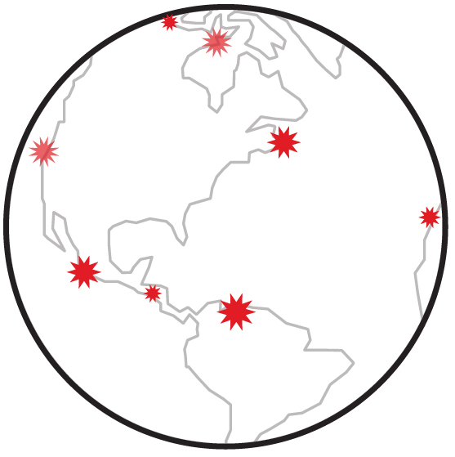
Key Findings
89%
Attacks-Success Rate (%)
Most Affected Nation IRAQ
Maximum 1570
Killed
Deadliest Terrorist Group
TALIBAN
Countries affected by Terrorism
190+

Slide 14
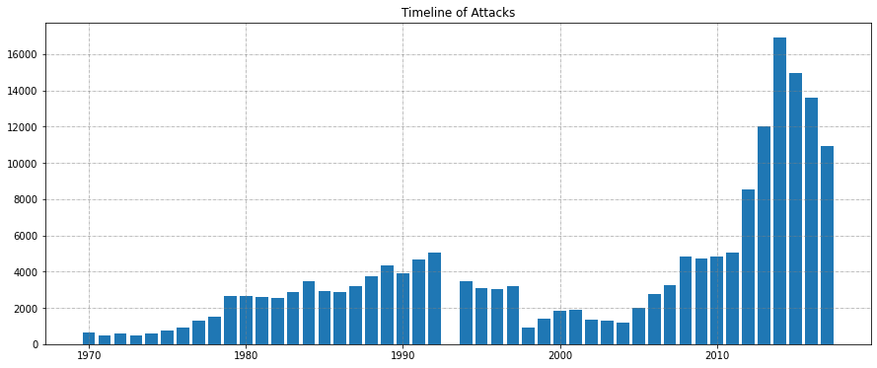
1.Number of Attacks in each Year(1970-2017)
Most Number of Attacks in year 2014:16903
Least Number of attacks in year 1971:471

Slide 15
Explanation:
The objective of this analysis is to better understand the terrorist activities through finding patterns and trends from the data.
From this analysis, all activities that occurred in a given year in each available geographical location in the world are represented. This study allows us to determine whether terrorist activities are increasing or decreasing per year.
We can see that in the year 2014 we had the most amount attacks and least amount attack in the year 1971. We can see that the number of attacks occurring increasing as the year progresses from 1970-2017 , so to understand the cause of drop in the number of attacks we made analysis further analysis on region wise attacks.
So that we could see which region is worst affected and which is best at tackling terrorism.

Slide 16
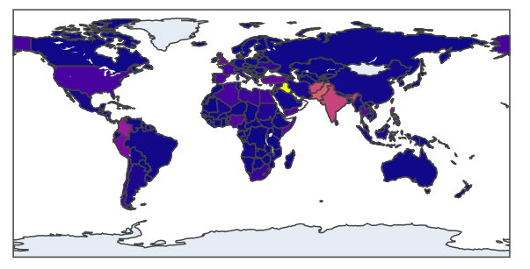
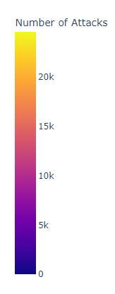
Measuring the Impact of Terrorism:
IRAQ-Most Impact Nation

Slide 17
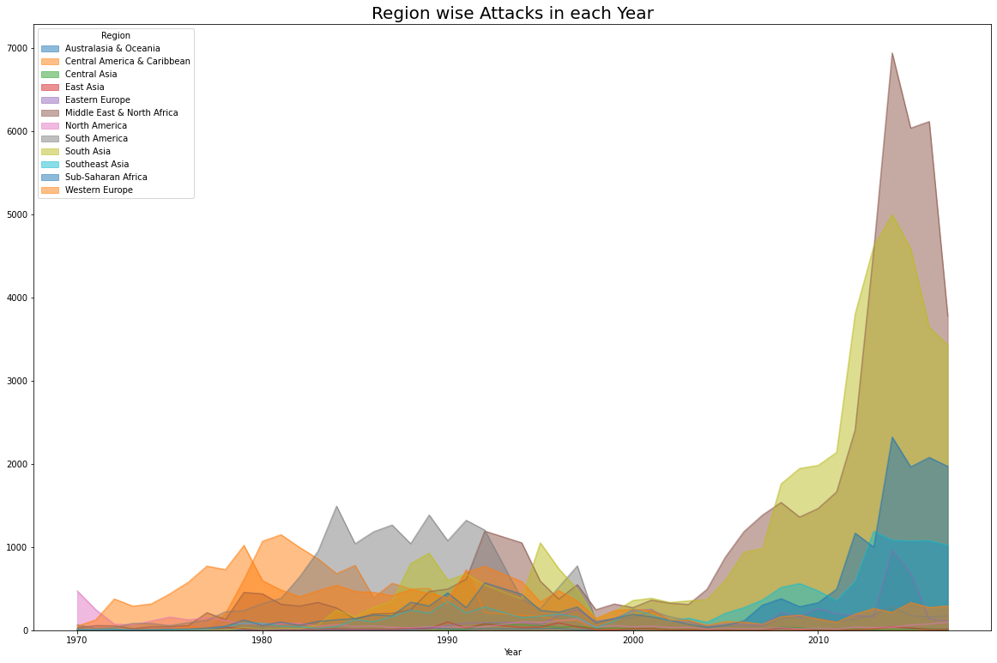
2.Region wise Impact:

Slide 18
Explanation:
In the region wise attacks we focused on year and the region features to find how the distribution of attacks in the region across the years.
This distribution will helps us to better understand that which are the region have to face most of the attacks through out the years.
We can see that recently middle east and north Africa are the worst affected regions followed by South asia.

Slide 19
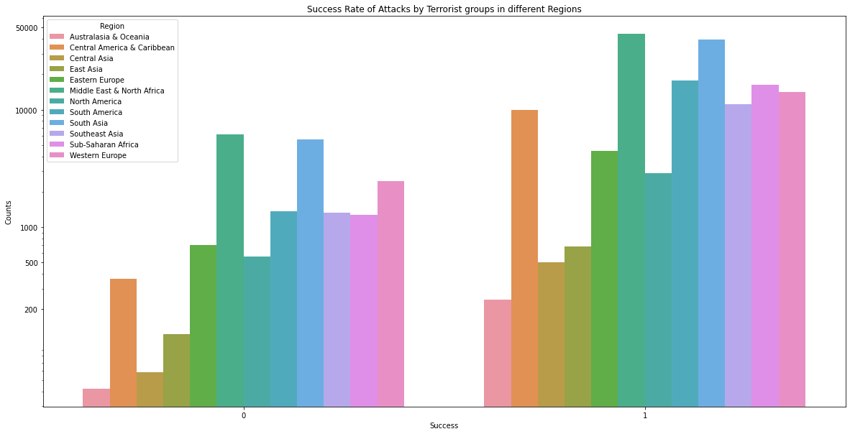
3.Success rates of Attacks by Terrorist group in each Regions
Most Impacted Region

Slide 20
Explanation:
To understand how well the regions have been in controlling the situation and preventing the attacks from being successfully executed.
We can see that maximum attacks successfully executed and failed by terrorists in Region Middle East & North Africa and minimum attacks successfully executed was in region Australasia and Oceania.

Slide 21
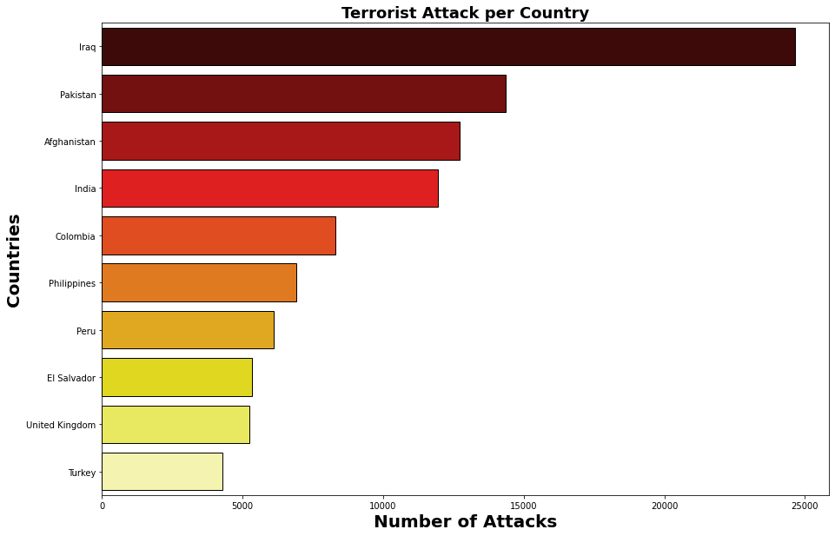
4.Total Number of Attack in Each Contry:

Slide 22
Explanation:
This analysis was carried out to see how each country in our dataset is affected by these attacks.
We have calculated the number of times the country has been there in the different terrorist attacks and through that we could find the total attack on each country.
We have plotted the top 10 countries with the highest attacks attempts.

Slide 23
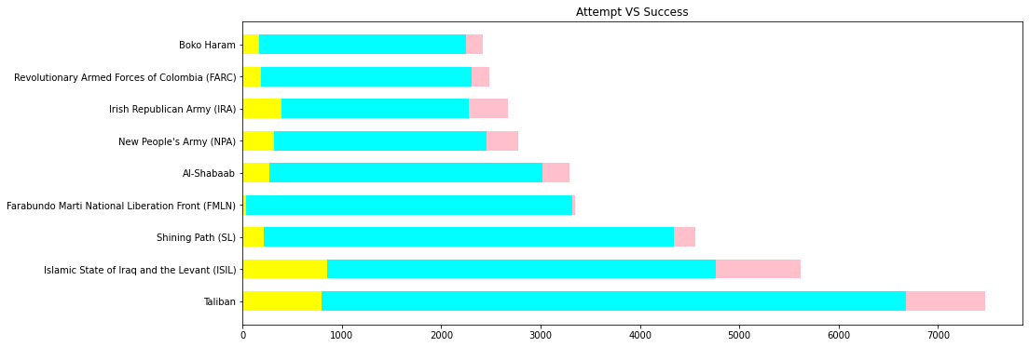
5.Top 10 Terrorist Groups who has Successfully executed their Attack Mission
Failed attempts
Successful attempts

Slide 24
Explanation:
This analysis will tell us which are the most dangerous terrorist organisations in world. Here we are using features like terrorist group, success, number of attacks as our features to find the ranking of the terror organisation with respect to successfully executed missions
Terrorist Group : Farabundo Marti National Liberation Front (FMLN) has the highest success rate of their Attack mission with 3351 total attempts and Success rate 98.98%
Taliban is the Top terrorist group with the attack mission with 7478. It has the success rate of 89.32%.

Slide 25
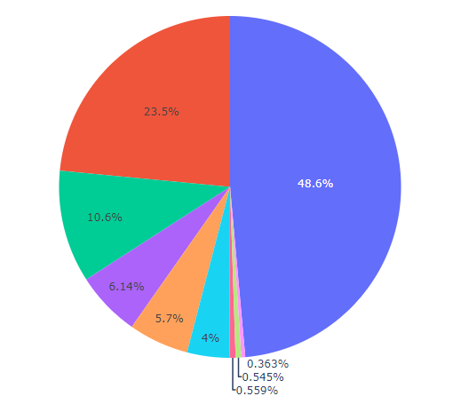
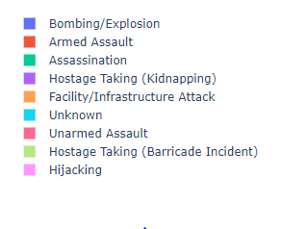
6.Most Attacked Methods used by the Terrorist groups

Slide 26
Explanation:
Here from this analysis we are trying to understand which attack methods are favoured by the terrorist groups for their attack missions
We select Attack_Type and Terrorist_Group as features to do this analysis
We see that most of the Deadliest terrorist groups have preferred Bombing and Explosion for their Attack mission about around 50%(actual-48.6%). This means they have the target on masses and explosive sources available for their Deadliest missions

Slide 27
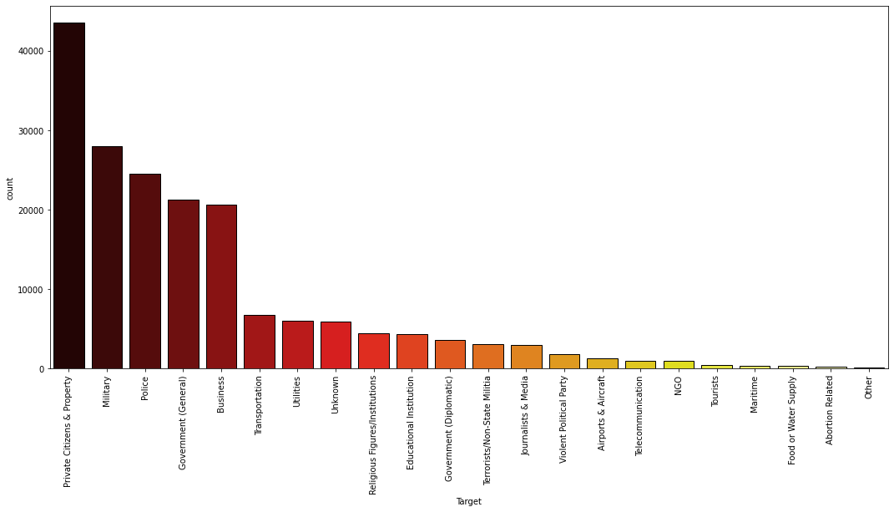
7.Targets of the Deadliest Terrorist Groups

Slide 28
Explanation:
In this analysis we have considered features like Target, country, and terrorist group.
This was done to understand the which are the targets more prone to the terrorism organisations attacks.
Terrorist Groups has targeted the Private citizens and Property with 43.511k attacks followed by Military with 27.984k attacks.

Slide 29
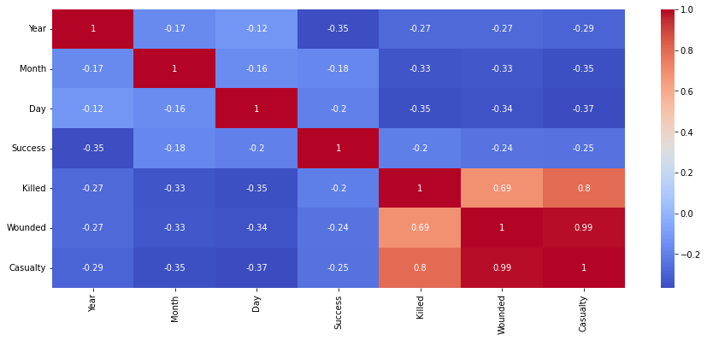
8.Correlation between Killed, Wounded and Total Casualty
*Heat Map(for visualizing the Intensity of the Correlation

Slide 30
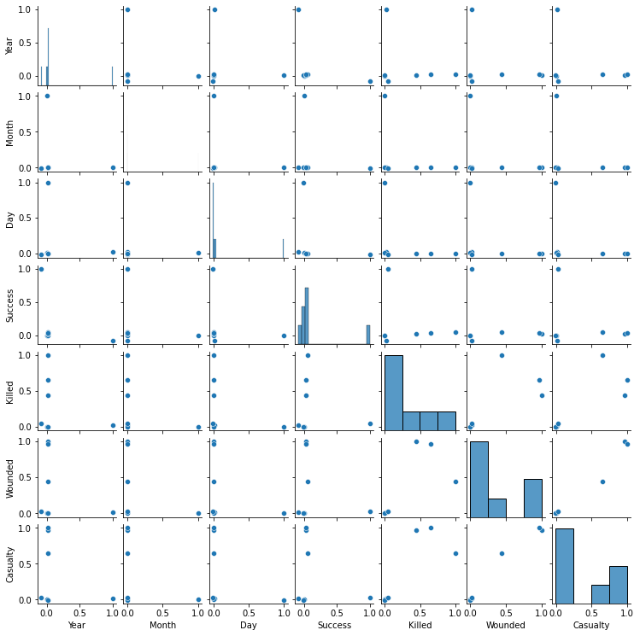
using the scatterplot to visualize the linear relationship

Slide 31
Explanation:
In this analysis we have attempted to find the linear relationship using correlation method between killed, wounded and total casualty.
We have imported all the numerical features in our analysis data set to find the correlation. The correlation between wounded and Casualty is 0.99 means 99% of the variance in Casualty, is accounted for by the wounded. The correlation between Killed and Casualty is 0.80 means 80% of the variance in Casualty, is accounted for by the Killed.
The correlation between wounded and Killed is 0.69 means 69% of the variance in Killed, is accounted for by the wounded.

Slide 32
Conclusions:

Slide 33
Starting with loading the data so far we have checked the data shape, data head, data info.
That's it! We reached the end of our exercise.
Then since the data contained lot of column labels so we filtered it to our need first then again imported the data to the Collab.
After that we looked for null values in the data set and started doing data cleaning till we successfully take care of null values.
Then Data visualisation was done for the analysis to find different trends according to our need for better understanding.
From the data we can see that middle east and Africa region were prone to more attacks
Iraq is the country with the highest number terrorist attacks
Terrorist Group Farabundo Marti National Liberation Front (FMLN) has the highest success rate of their Attack mission with 3351 total attempts and Success rate 98.98%.
Taliban is the Top terrorist group with the attack mission with 7478. It has the success rate of 89.32%. Most of the Deadliest terrorist groups have preferred Bombing and Explosion for their Attack mission about around 50%(actual-48.6%).
This means they have the target on masses and explosive sources available for their Deadliest missions.
Terrorist Groups has targeted the Private citizens and Property with 43.511k attacks followed by Military with 27.984k attacks.
The Most common weapon used for the Deadliest Missions are explosives mainly for bombing and explosions. Followed by Firearms for the Armed Assault.

Slide 34
The correlation between wounded and Casualty is 0.97 means 97% of the variance in Casualty, is accounted for by the wounded.
The correlation between Killed and Casualty is 0.58 means 58% of the variance in Casualty, is accounted for by the Killed.
The correlation between wounded and Killed is 0.38 means 38% of the variance in Killed, is accounted for by the wounded.

Slide 35
References

Slide 36
[1] United Nations, “Chapter-1 Purposes and Principles,” [Online]. Available: https://www.un.org/en/sections/un-charter/chapter-i/index.html [Accessed: May 2019].
[2] A. Z. Borda, “Why we react differently to terror attacks depending on where they happen,” [Online]. Available: http://theconversation.com/why-we-reactdifferently-to-terror-attacks-depending-on-where-they-happen-57389 [Accessed: May 2019].
[3] START organization, “Global Terrorism Database,” [Online]. Available: https://www.start.umd.edu/gtd/about/ [Accessed: May 2019].
[4] ALMABETTER [Online],https://learn.almabetter.com/courses/take/team-capstone-projects/texts/19443222-world-bank-global-education-analysis

